Slide 1
Affordable Single Family Development
DCHI Webinar
November 19, 2020

Slide 2
Wisconsin Partnership for Housing Development
Creating Homes. Building Opportunity.
Our Mission:
The Wisconsin Partnership for Housing Development expands access to affordable housing opportunities and revitalizes neighborhoods through partnerships among the public, nonprofit and private sectors.

Slide 3
Wisconsin Partnership for Housing Development
Single-Family Development for Homeowners
Affordable rental housing
Program Administration & Technical Assistance for communities/partners
Homeowner Rehabilitation for elderly, disabled, and low-income households
Down Payment Assistance
Advocacy

Slide 4
Housing Need in Wisconsin
Existing housing stock is aging.
Construction prices and housing costs are rising faster than inflation and incomes.
Declining homeownership, particularly among younger families, first-time homebuyers, and African American and Hispanic families.
Compared to our neighboring states, we have the highest rate of extreme rental cost burden for lower-income families and the second highest rate of extreme cost burden for lower-income homeowners.
Source: “Falling Behind – Special Report”, WI Realtors Association, 2019

Slide 5
Single Family Development
How can we create homeownership opportunities for more households?
Over the past 10 years, WPHD has constructed and rehabbed 60 single-family homes and sold them to qualified households at or below 80% Area Median Income.
All buyers attend Homebuyer Education Counseling from a HUD-certified counselor.
All buyers receive down payment assistance.
Extensive home rehab ensures home is safe, energy efficient, and affordable to maintain in the first years of homeownership.
Subsidy is needed due to mismatch of costs and affordable house prices

Slide 6
Single Family Development: Funding
Partnership with community utilizing HOME/CDBG funds
Federal funds are allocated annually by the local PJ (Participating Jurisdiction) or the State
Cities of Eau Claire, Green Bay, Kenosha, La Crosse, Madison, Milwaukee, Racine
Dane County, Rock County Consortium, Milwaukee County, Waukesha County Consortium (Waukesha, Jefferson, Washington, Ozaukee Counties)
Homes and vacant lots may be foreclosed
Bridge Loan from third party lender for construction costs

Slide 7
Example: City of Janesville
Identified two downtown neighborhoods that had been devastated by the closure of the GM plant and then by the national foreclosure crisis.
Numerous vacant homes created neighborhood instability and crime.
Started with Neighborhood Stabilization Program (NSP) funds to demolish/repair homes, continued with HOME/CDBG
WPHD has renovated and newly constructed over 20 homes and the City has completed many others.
Vacancy rates are reduced and property values have increased

Slide 8
WPHD in Janesville

Slide 9
Example: New Construction
Sources |  | Uses
HOME | $100,000 | Acquisition | $0
Bridge Loan | $105,000 | Construction | $205,000
WPHD | $18,000 | Soft Costs | $18,000
TOTAL | $223,000 | TOTAL | $223,000
Sale to Homeowner
Sales Price | $150,000
Seller Closing Costs | ($11,000)
Bridge Loan Repayment | ($105,000)
WPHD Reimbursement | ($18,000)
Down Payment Assistance Left In | ($5,000)
Final Proceeds | $11,000

Slide 10
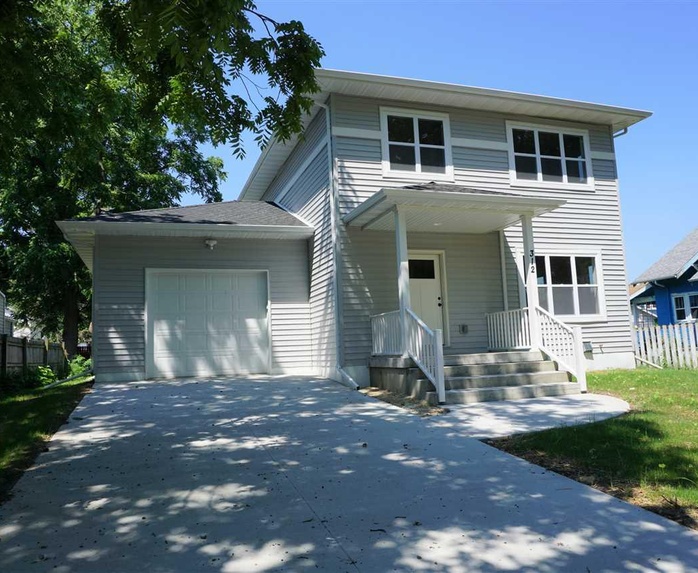
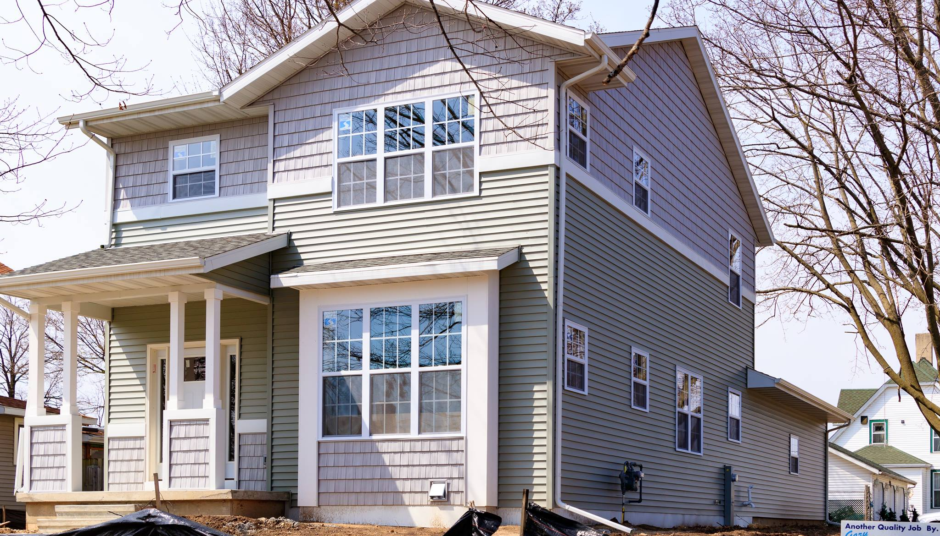
3 Bedroom / 2 Bath, 1 car garage
1500-1600 SF
Construction: approx. $205,000

Slide 11
Example: Acquisition + Rehab
Sources |  | Uses
HOME | $75,000 | Acquisition | $65,000
Bridge Loan | $90,000 | Construction | $95,000
WPHD | $15,000 | Soft Costs | $20,000
TOTAL | $180,000 | TOTAL | $180,000
Sale to Homeowner
Sales Price | $130,000
Seller Closing Costs | ($9,500)
Bridge Loan Repayment | ($90,000)
WPHD Reimbursement | ($15,000)
Down Payment Assistance Left In | ($5,000)
Final Proceeds | $10,500

Slide 12
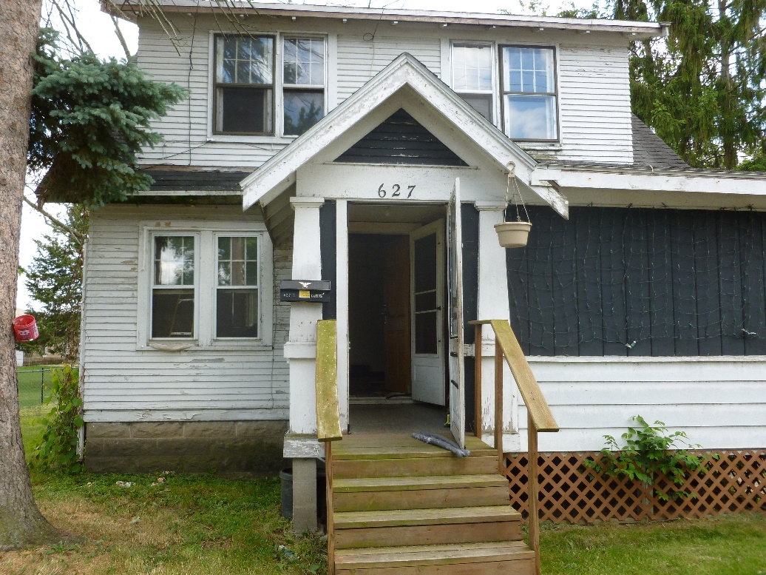
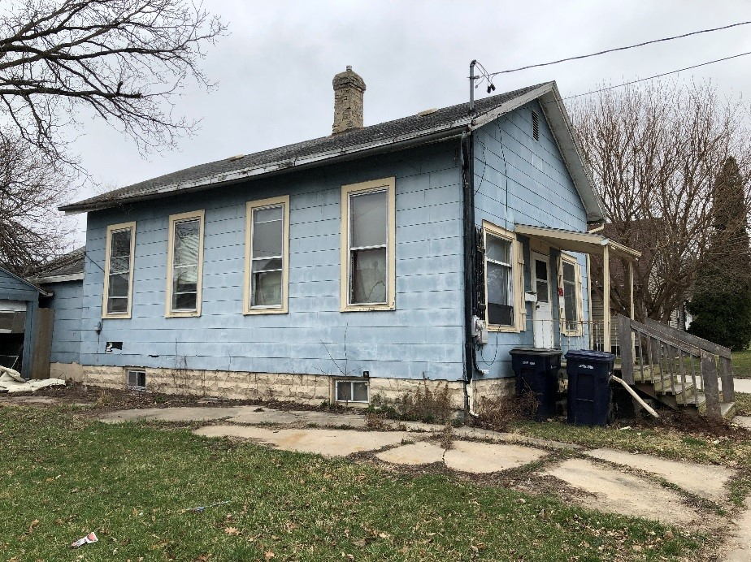
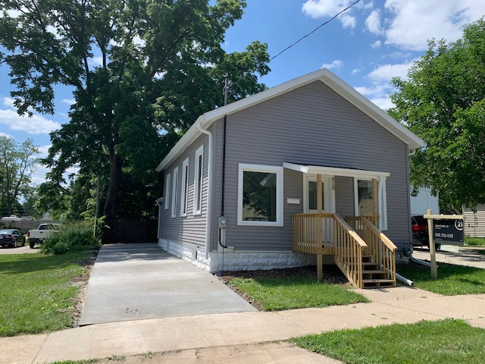
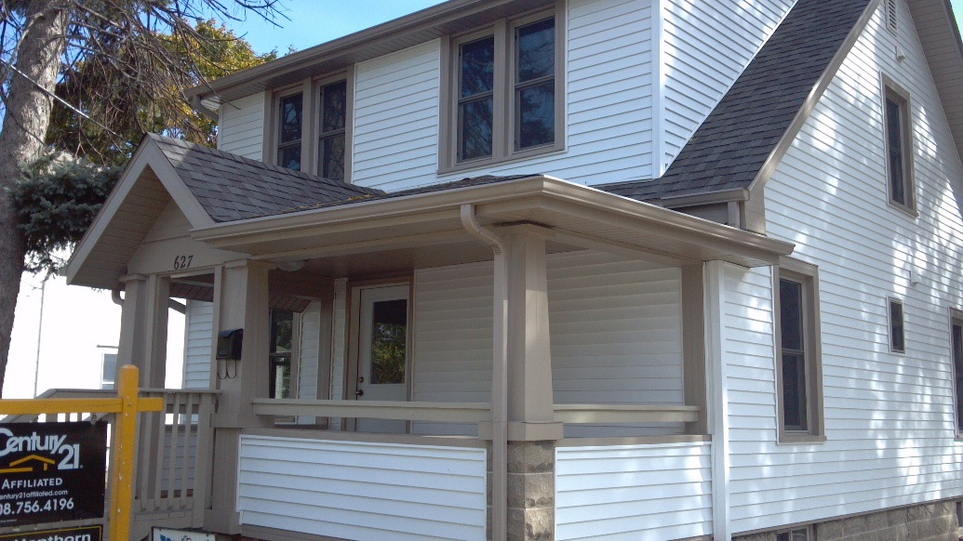

Slide 13
Single Family Development: Results
Improvements in Housing Stock
Creation of affordable workforce housing
Long-term investment and wealth building
Stability for families

Slide 14
Single Family Development: Dane Co
HOME Funds from Dane County and City of Madison
Same financial structure
Remaining HOME funds at sale are transferred to buyer as down payment assistance
80% AMI Households:
1 person - $56,080
2 people - $64,080
4 people - $80,080

Slide 15
Other Homeownership Tools
Rehab loans for new/existing homeowners
Adjust zoning requirements, fees, other infrastructure costs to reduce housing costs
Homebuyer Education
Down Payment Assistance
Lack of wealth limits households from becoming homeowners
Variety of forms – deferred loans, low or no interest, shared appreciation
Funds from federal sources, WHEDA, FHLB, and private sources
Educate lenders and realtors
Opportunities for innovation –employers, realtor associations, or targeted to specific neighborhoods

Slide 16
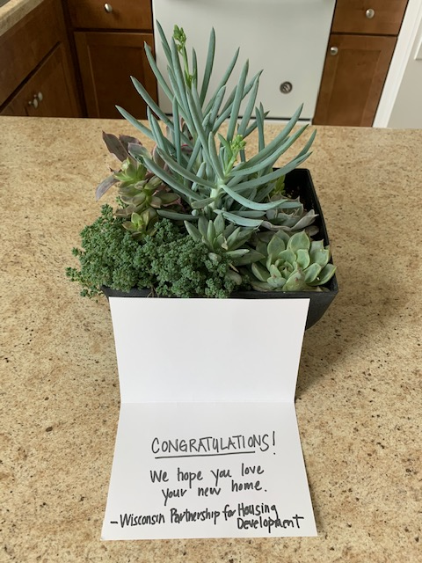
Nicole Solheim
Executive Director
Wisconsin Partnership for Housing Development
nicolesolheim@wphd.org
(608)258-5560 x34

